Slide 1

Viva Connections & SharePoint Framework Bi-weekly sync
aka.ms/m365pnp
Your host in this call: Patrick Rodgers
April 21, 2022
Microsoft 365 PnP Team

Slide 2





Agenda
Latest update on SharePoint Framework
Patterns and Practices Updates
PnPjs
CLI for Microsoft 365
Reusable PnP SPFx controls
New Community Samples
Picture time with Together Mode!
Demos
Derek Cash-Peterson - Adaptive Card Design Gallery
Fabio Franzini - Using Adaptive Cards control from the PnP control gallery in SPFx solutions
Paolo Pialorsi - Navigating Cards in Viva Connections ACEs
Have a great day! 👍
You are awesome! 🧡
Thank you for being part of the community 👏

Slide 3
Opportunities to Participate in PnP SPFx / JS SIG
SPFx Demo
@pnp Demo
Contribute on GitHub
Provide Feedback
Web Part
Application Customizer
Provisioning
Anything you create!
PnPjs
CLI for Microsoft 365
SPFx Reusable Controls
SPFx Community Yeoman
Report Issues
Submit Pull Requests
Help with issues/questions
How are the calls?
Documentation needs?
Where can we help?
Positive is OK too!
Great opportunity to get visibility for you or your company. Demo sample or explain how you extend or customize SharePoint Online with live demo in your projects. Reach out to team for volunteering.
Request a demo spot on the call
https://aka.ms/m365pnp/request/demo

Slide 4
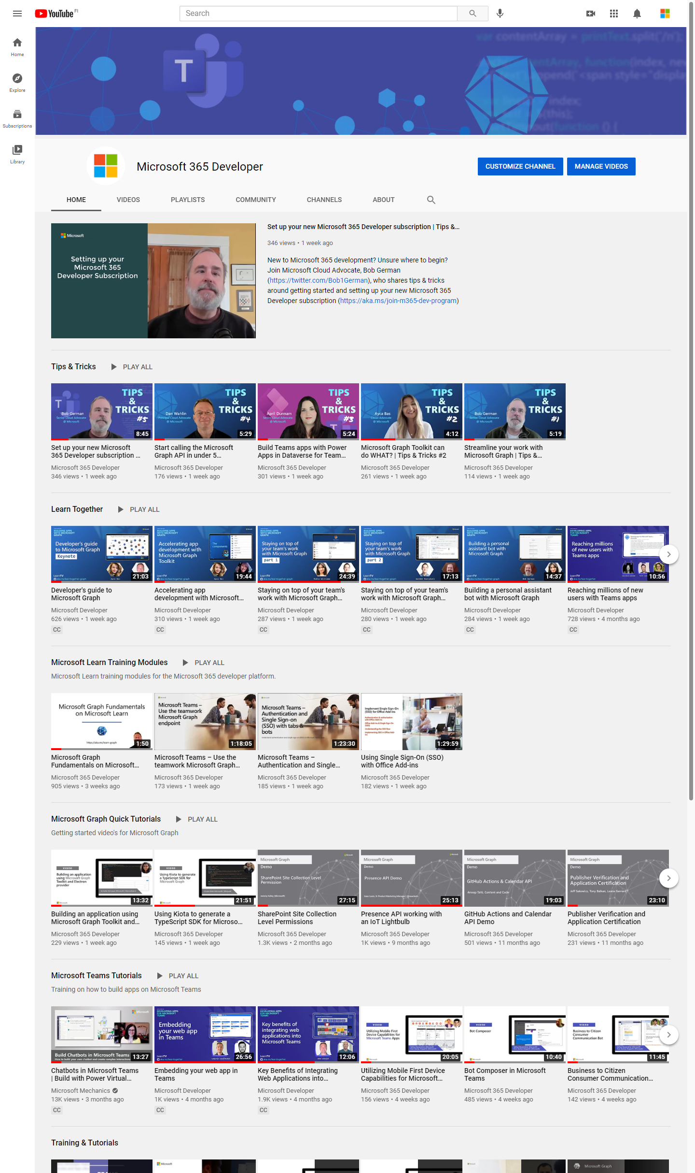
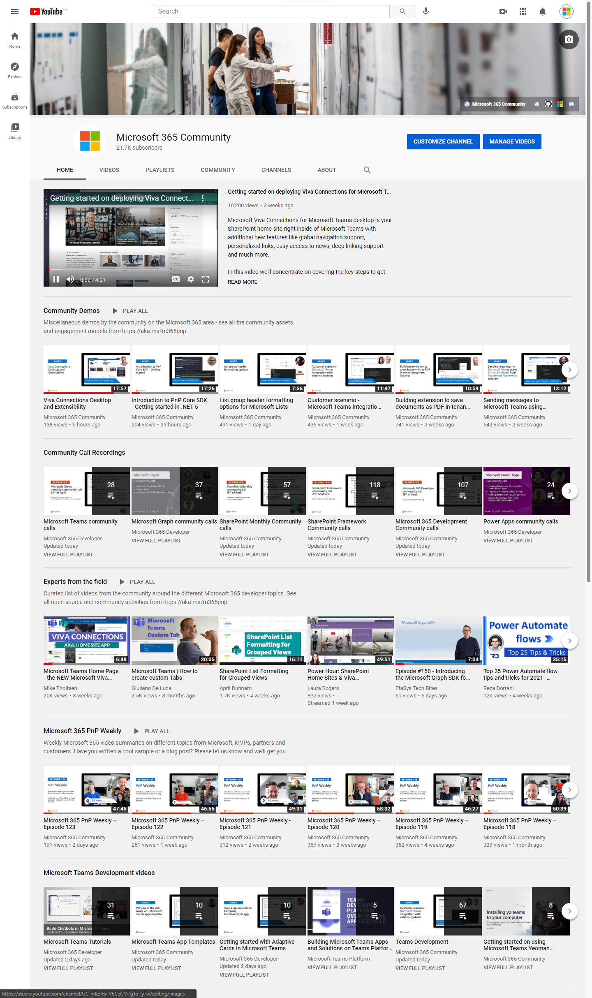
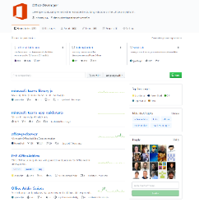
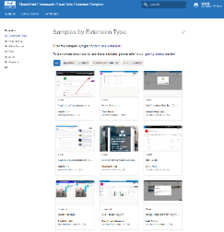
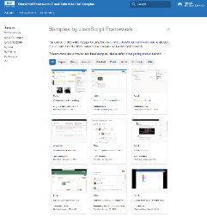
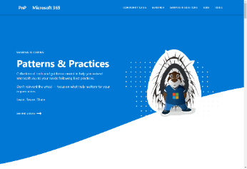
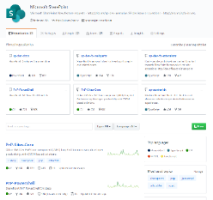
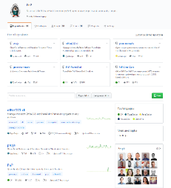
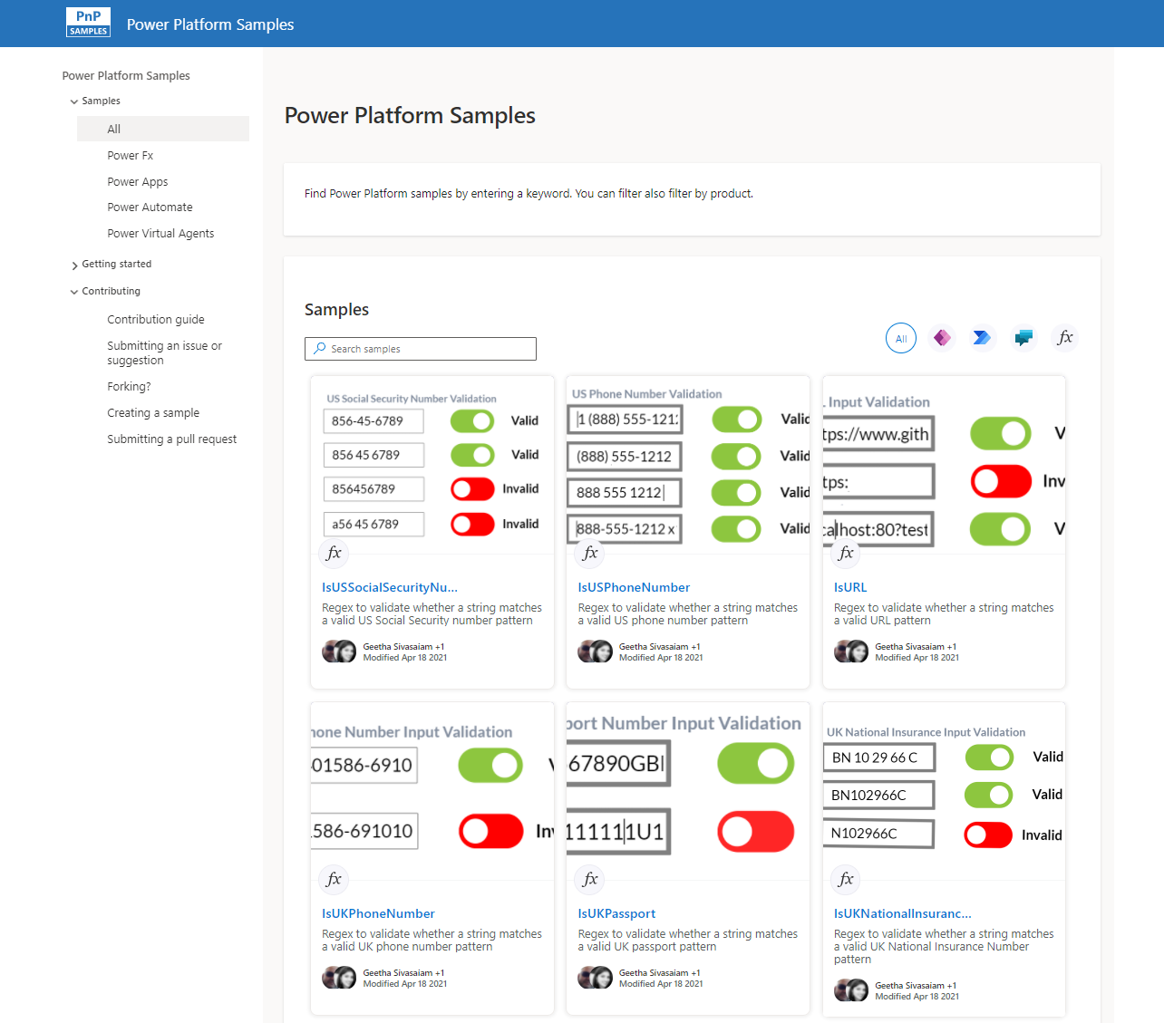
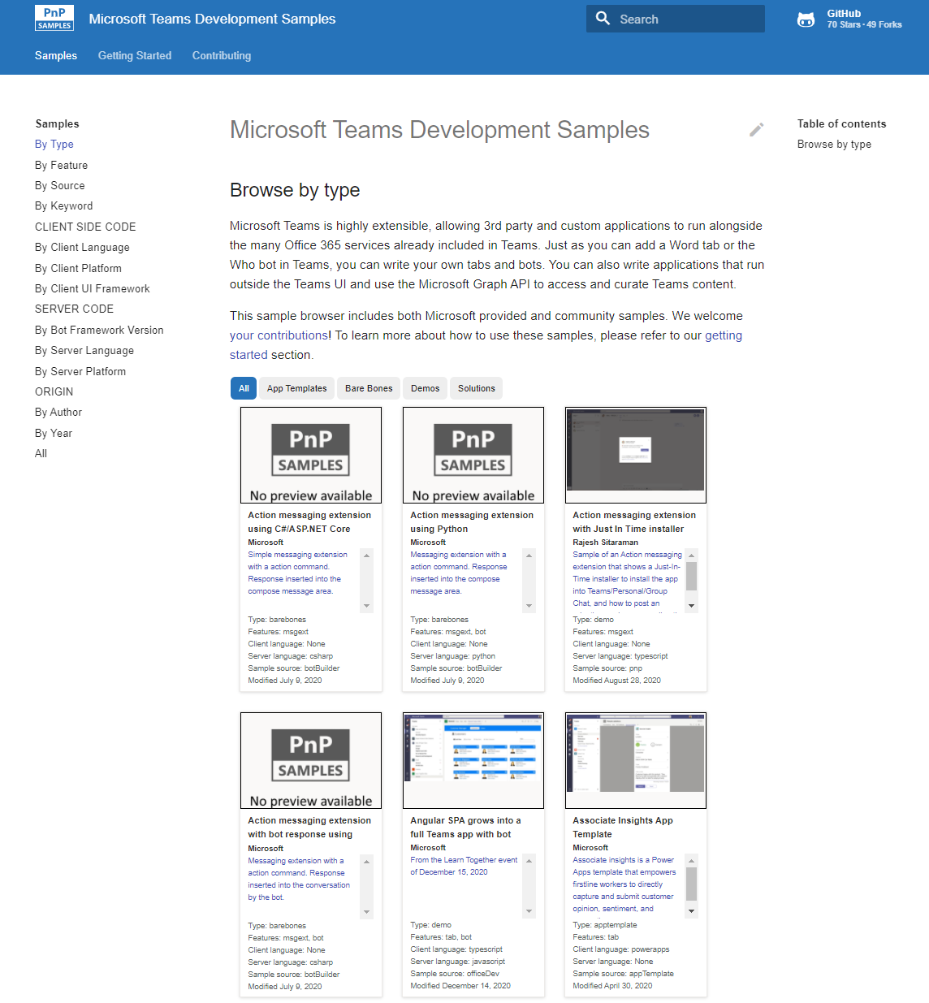
Microsoft 365 developer videos
Microsoft 365 community videos
Open-source
Sample galleries
Open-source initiatives and samples
aka.ms/m365devyoutube
aka.ms/m365/videos
github.com/pnp
github.com/officedev
github.com/microsoftgraph
github.com/sharepoint
aka.ms/m365/samples
aka.ms/teams-samples
aka.ms/spfx-webparts
aka.ms/spfx-aces
aka.ms/powerplatform-samples
aka.ms/spfx-extensions
aka.ms/list-formatting
aka.ms/m365pnp
@Microsoft365Dev | @m365pnp
One URL to rule them all…

Slide 5
Microsoft 365 developer community calls
Microsoft 365 platform https://aka.ms/m365-dev-call
Adaptive Cards https://aka.ms/adaptivecardscommunitycall
Microsoft identity platform https://aka.ms/IDDevCommunityCalendar
Office Add-ins https://aka.ms/officeaddinscommunitycall
Power Platform https://aka.ms/PowerPlatformMonthlyCall
Microsoft 365 Dev Community (bi-weekly) https://aka.ms/m365-dev-sig
Viva Connections and SPFx (bi-weekly) https://aka.ms/spdev-spfx-call
https://aka.ms/m365pnp
Notes:
m365-dev-sig

Slide 6

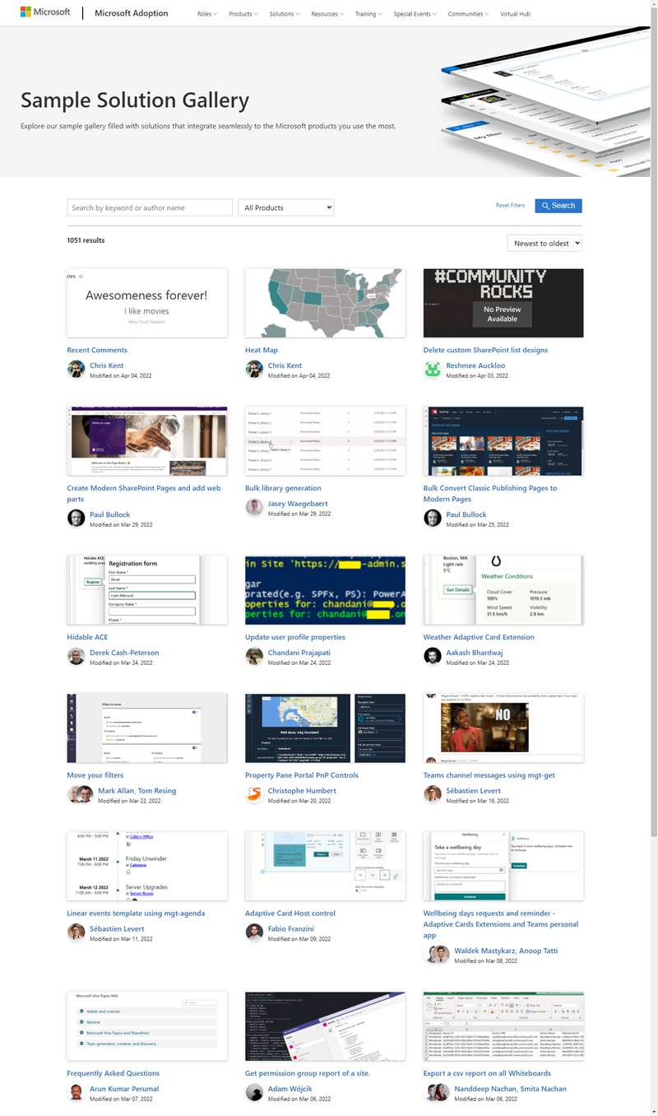
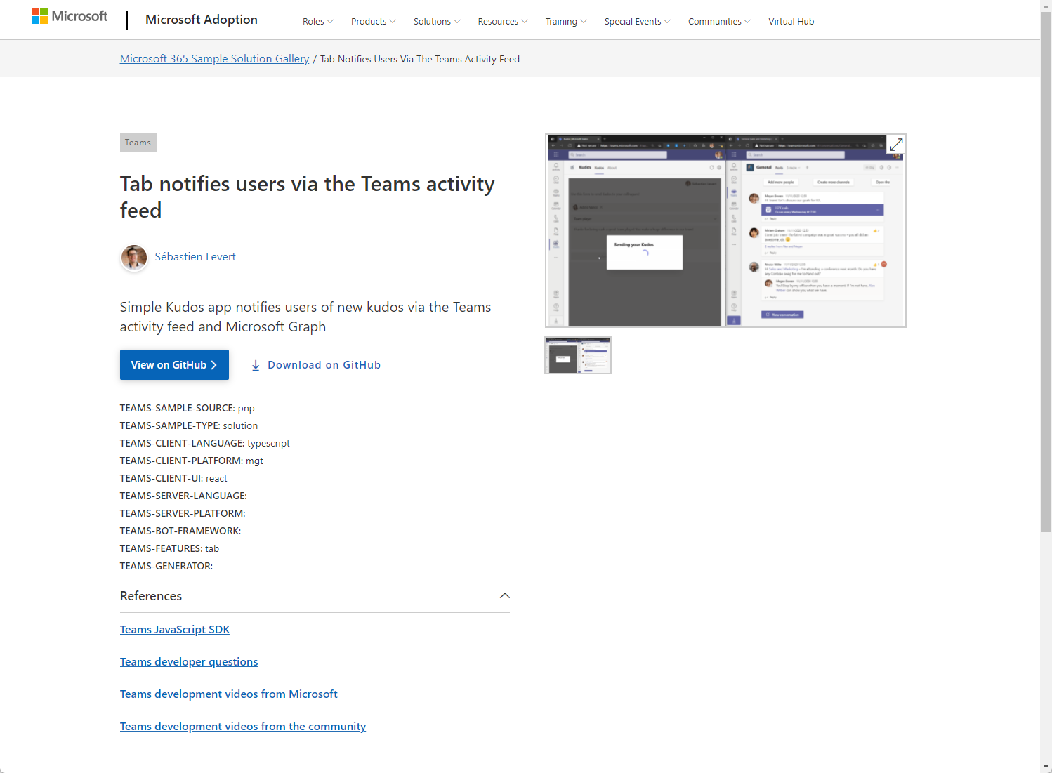
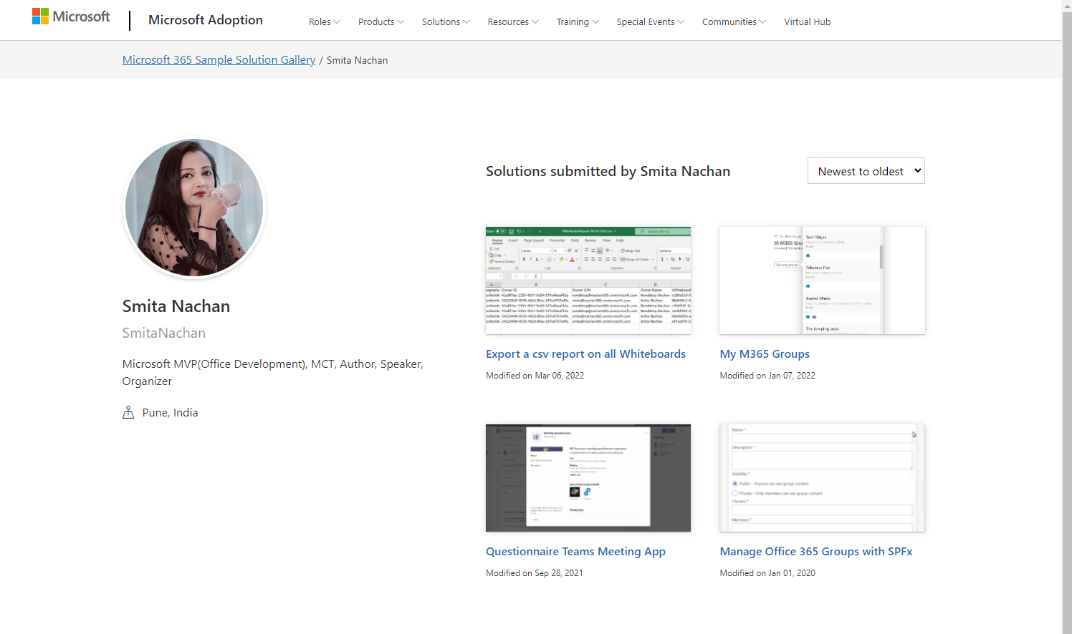

SAMPLES
Announcing new Microsoft 365 Unified Sample Gallery
Find all Microsoft 365 samples from Microsoft and community from one centralized location
https://aka.ms/m365/samples
Notes:
Dan’s slide

Slide 7





Latest news from Microsoft engineering on Microsoft 365 topics
Community together mode group photo
Divyanka Pillai and Michelle Lee - Create an app that extends across Teams, Outlook, and Office
Waldek Mastykarz and Alex Terentiev - Easily fix errors in your SPFx projects with CLI for Microsoft 365
AGENDA
Microsoft 365 platform call 26th of April @ 8 AM PT
Weekly call with Microsoft presenters covering the latest Microsoft 365 platform updates
Download recurrent invite from https://aka.ms/m365-dev-call
Notes:
Dan’s slide

Slide 8
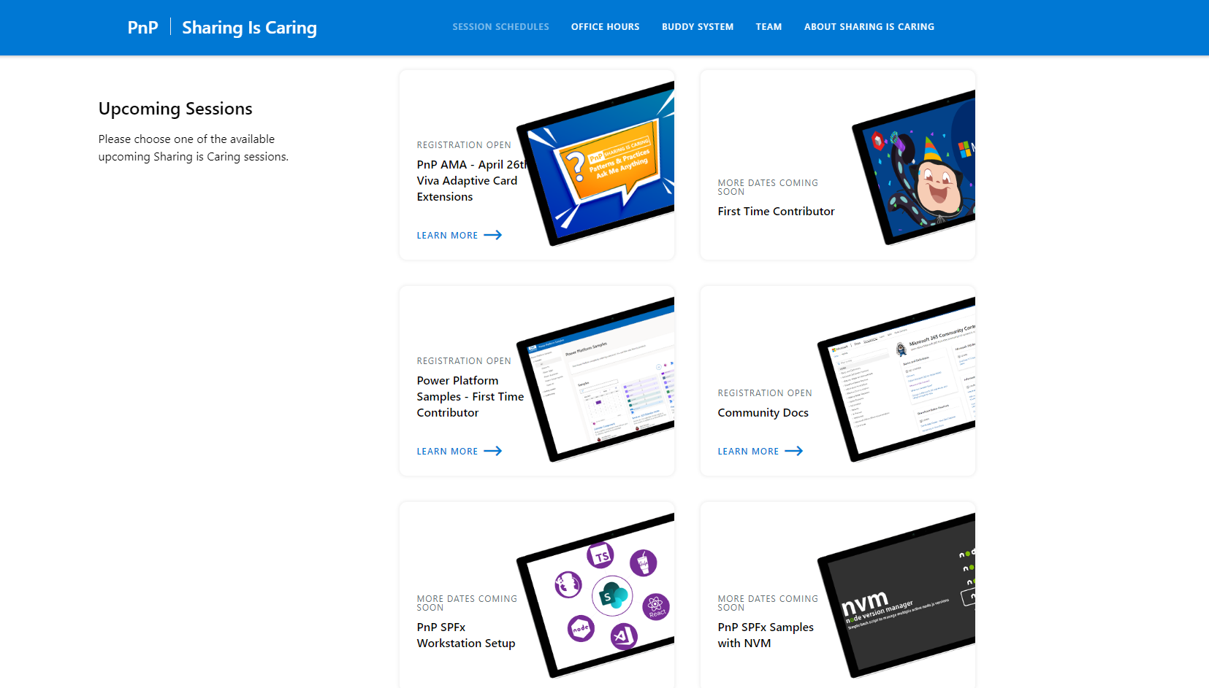
GUIDANCE
Learn how to get started in the open-source PnP community!
Upcoming Sessions:
First-time contributor
Power Platform Samples – First Time Contributor
Community docs
Using PnP SPFx samples w/ NVM
SPFx developer workstation setup
More than code with VS Code
First-time presenter
M365 Maturity Model Practitioners
Ask me Anything (Viva Connections – April 26th)
NEXT WEEK!!
https://aka.ms/sharing-is-caring
Notes:
25 Total attendees, 16 attendees who attended both First-Time Contributors and Community Docs sessions.

Slide 9
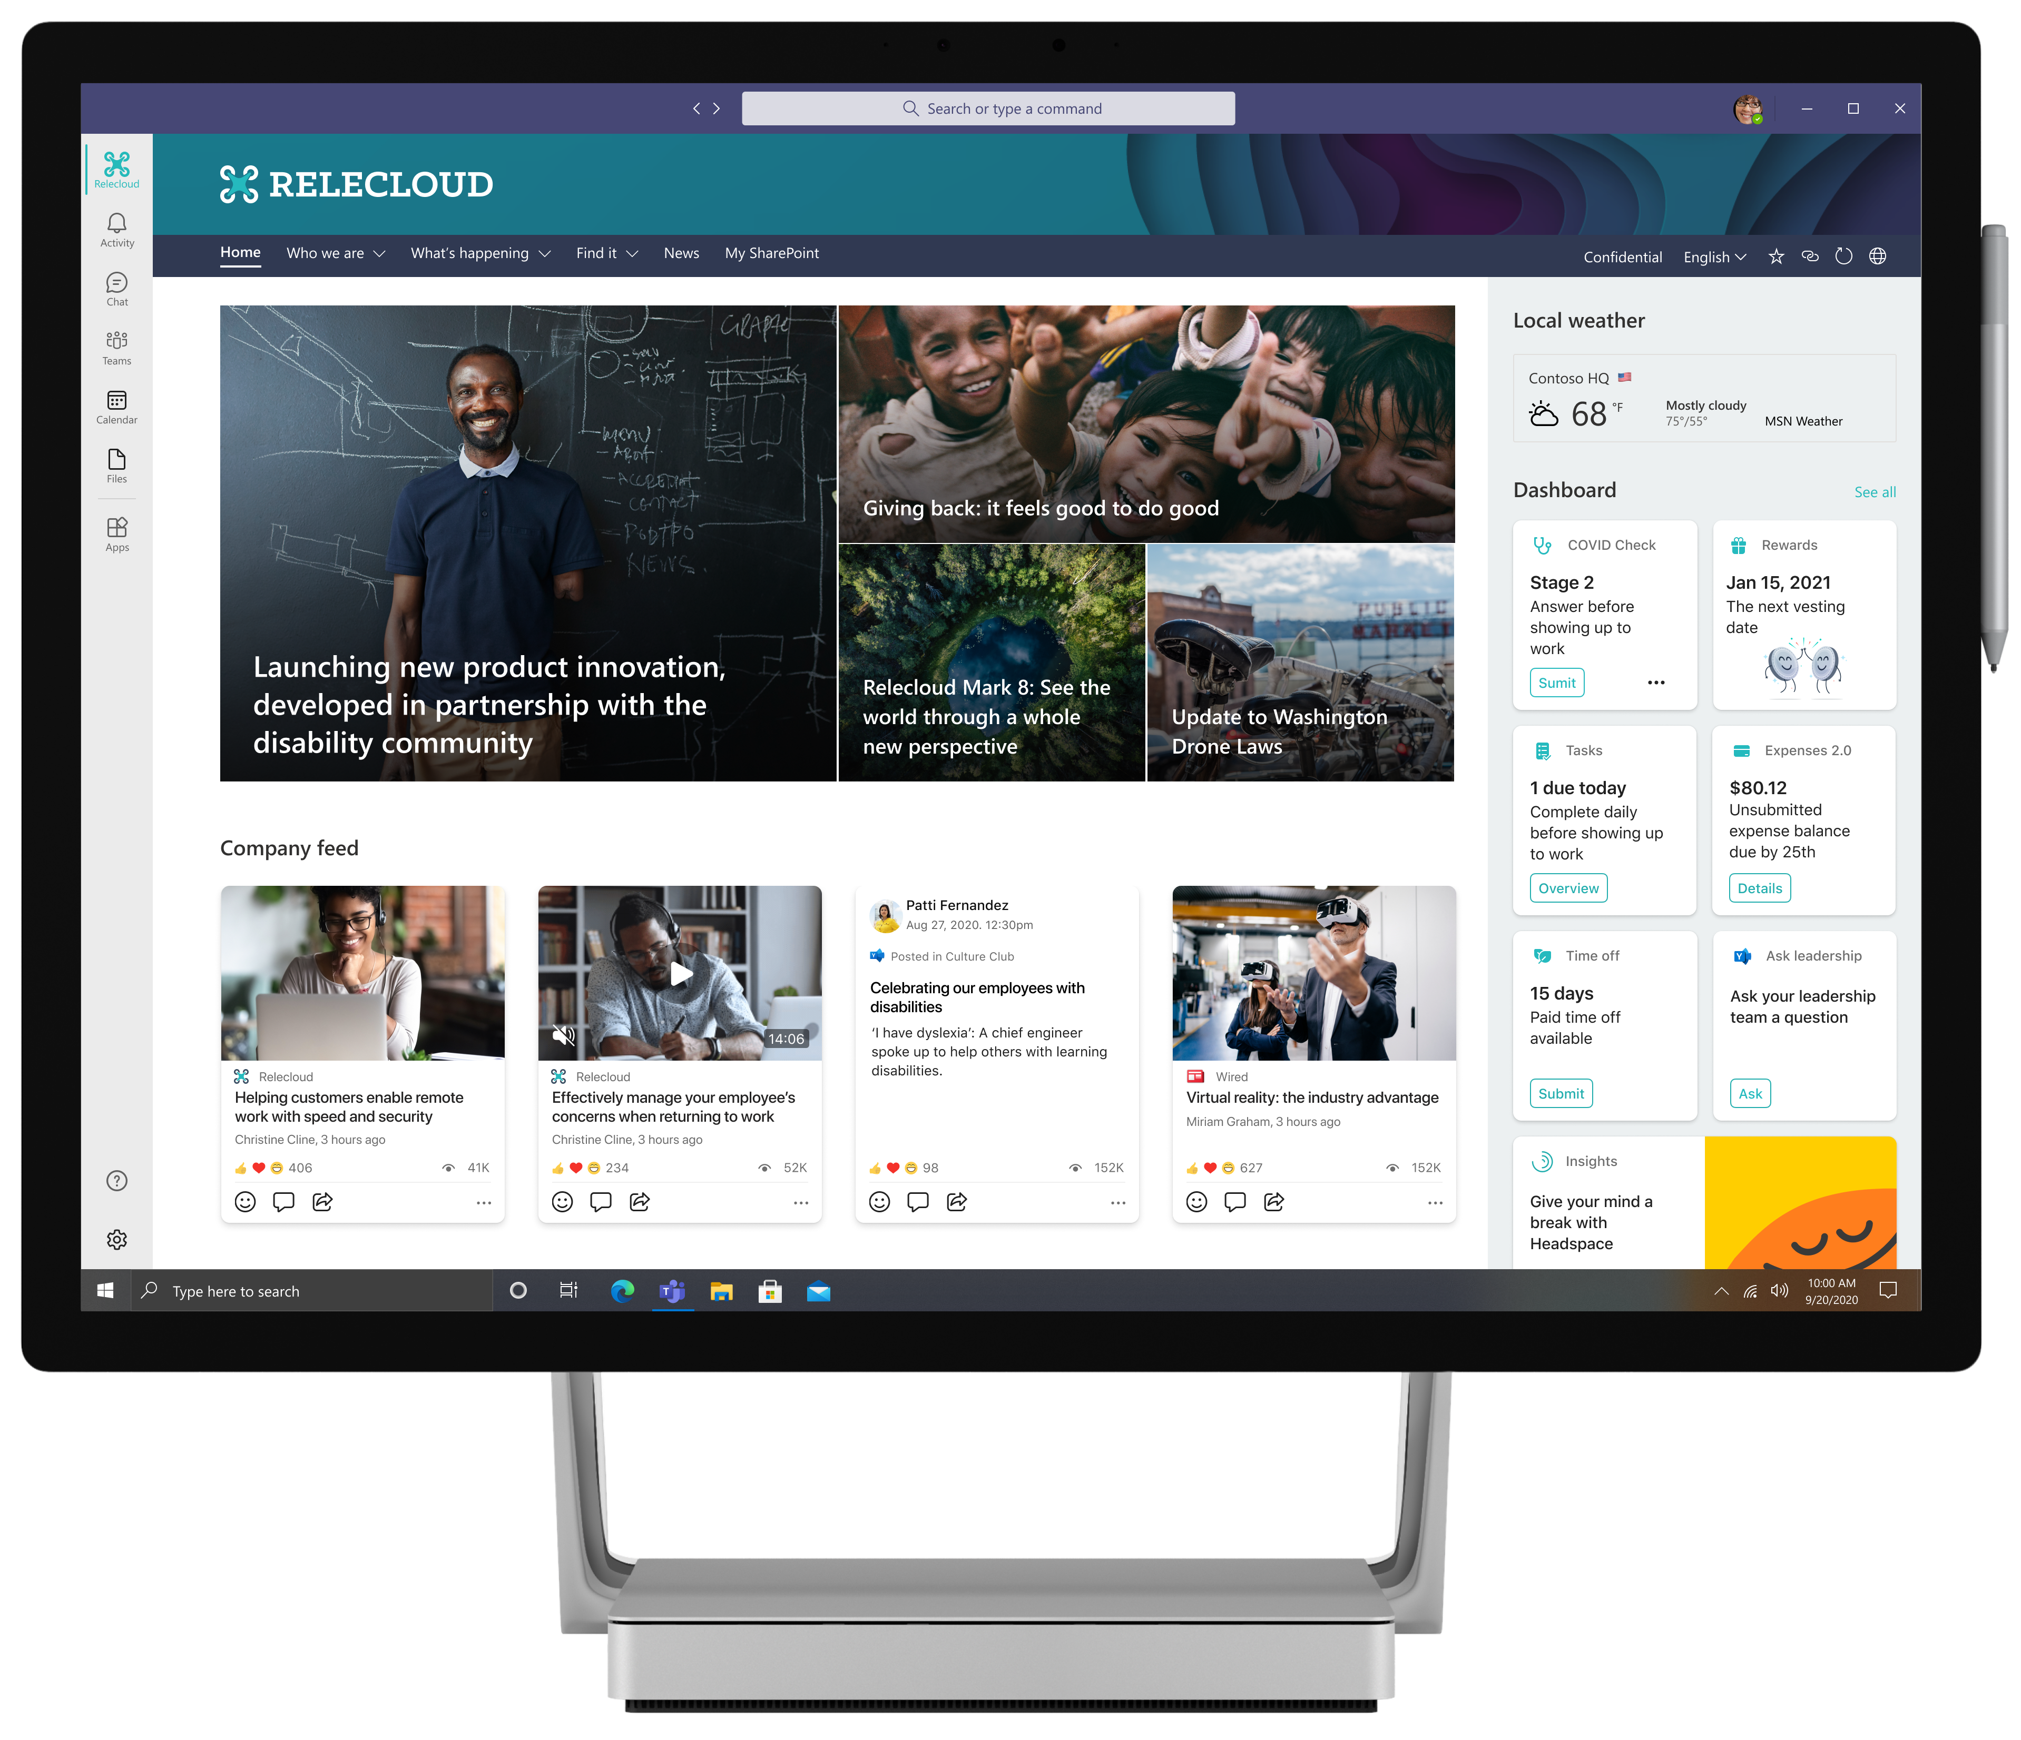
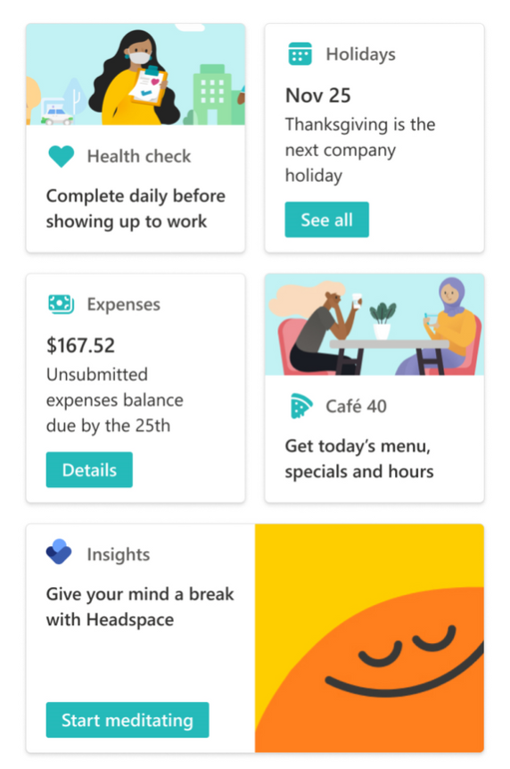
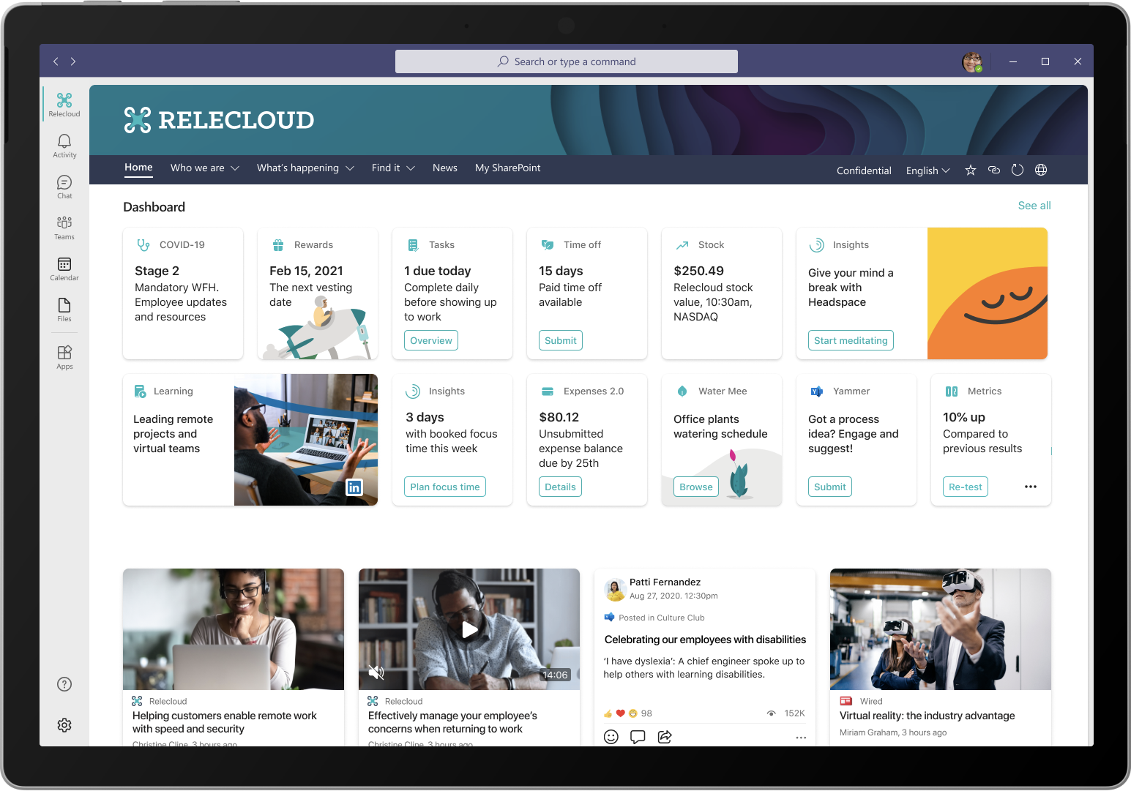

26th of April 9 AM PT
AMA
Got questions on Viva Connections development? Don’t miss out this event!
Ask-Me-Anything (AMA) event with Microsoft Viva Connections platform engineering team on 26th of April 9 AM PT
Register today! https://aka.ms/viva-ama-april-2022
Notes:
Dan’s slide

Slide 10





COMMUNITY
PnP Recognition Program
Showcase your contributions
Powered by Credly
More achievement levels coming soon
https://aka.ms/m365pnp-recognition
Notes:
25 Total attendees, 16 attendees who attended both First-Time Contributors and Community Docs sessions.

Slide 11
SharePoint Framework Latest from Microsoft engineering for Microsoft Viva, Microsoft Teams and SharePoint extensibility

Slide 12
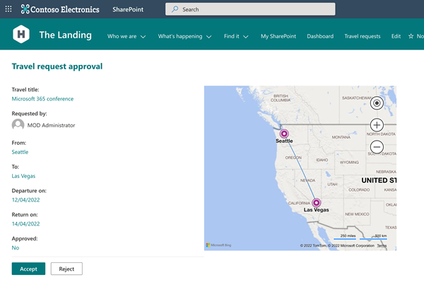
List form extensibility preview included!
UPDATE
Updated SharePoint Framework 1.15 public developer preview!
Preview on the upcoming SharePoint Framework version now available with updated features for Microsoft Teams, Microsoft Viva and SharePoint Online
npm install -g @microsoft/generator-sharepoint@next
Notes:
Dan’s slide

Slide 13
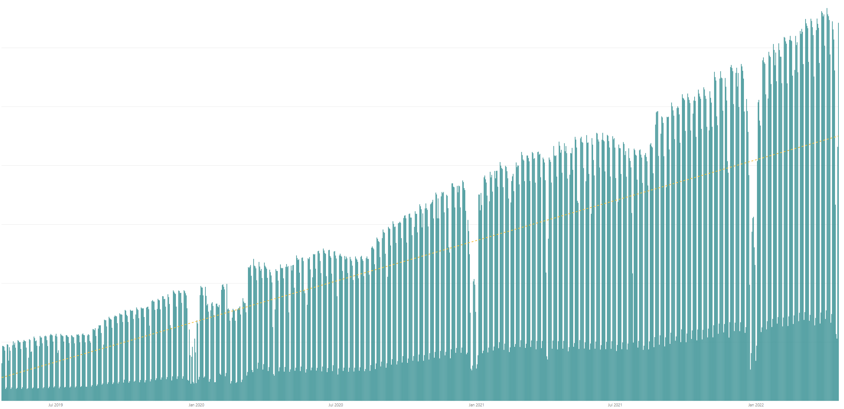

Daily active users for custom SharePoint Framework components in M365 There are currently tens of millions of monthly active users for customer and partner created SharePoint Framework components in Microsoft 365
Jul 2019
Jan 2020
Jul 2020
Jan 2021
Jul 2021
Jan 2022

Slide 14




The Road Ahead – 1.15 Release – ETA June 2022
Q2 CY 2022
Latest 1.15 preview release
New Action types for media and geolocation – Tutorial just published
Support for Microsoft Graph SDK V3
Bug fixes and adjustments based on GitHub issues
New customizers for add and edit list / library forms
Available later as we progress in 1.15 development
Adaptive Card Extensions card view caching
Adaptive Card Extensions Error Handler Method
Isolated Adaptive Card Extensions (Beta)
Adaptive Card Extensions card view caching – move to GA
Leverage Teams OBO flow for SPFx components in Teams Web
Support for TypeScript V4
Support for Node V16
Support for Teams SDK v11 (or newer if available)
Enable Service Principal Registration in app acquisition flow
Post 1.15 - Bots Powered Adaptive Card Extensions (Beta)**

Slide 15

PnPjs Client-Side Libraries

Slide 16
























PnPjs Client-Side Libraries
Version 3.2 released April 8th
General documentation updates
Fix (and doc update) for using esm modules in TypeScript solutions that output commonjs
Fixed bugs (SendEmail, getAllChildrenAsOrderedTree, stale request digests, renderListDataAsStream, etc)
Added to graph (getById for Site, transitiveMemberOf for User, installedApps for Team)
Doc updates (using Web constructor, importing both graph and sp SPFx behavior, etc)
Don’t forget about the nightly builds
npm install @pnp/sp@v3nightly --save
Docs: https://pnp.github.io/pnpjs/ @m365pnpjs on twitter

Slide 17
CLI for Microsoft 365

Slide 18
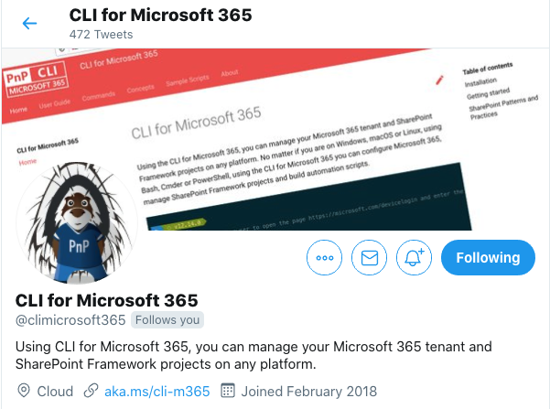
CLI for Microsoft 365
New preview version v5.2 with:
SPFx project upgrade guidance including SPFx fast serve
Support for adding private Teams channels
Managing Teams chat memberships
Managing Power Platform management apps
Retrieving AAD signins information
Install v5.2 preview:
npm install -g @pnp/cli-microsoft365@next
docker run --rm –it m365pnp/cli-microsoft365:next
Release notes:
https://pnp.github.io/cli-microsoft365/about/release-notes/#v520
Available natively in Azure Cloud Shell
@climicrosoft365 #CLIMicrosoft365 on Twitter
📖 aka.ms/cli-m365
🗣 github.com/pnp/cli-microsoft365/discussions

Slide 19
SPFx Reusable Components

Slide 20
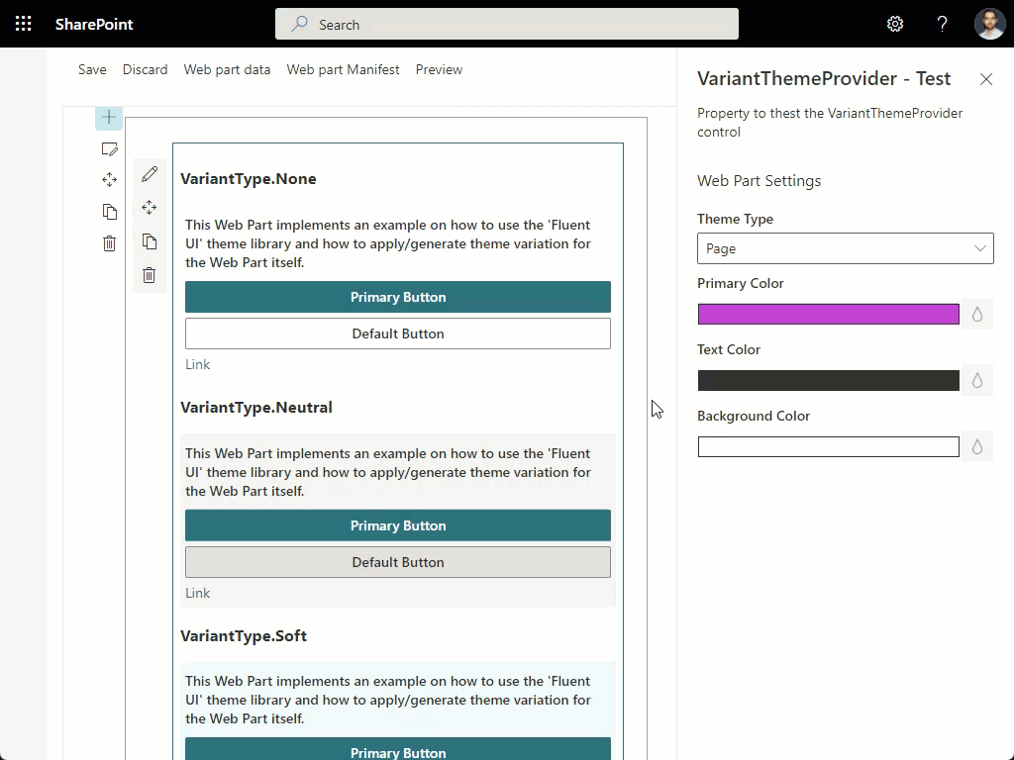
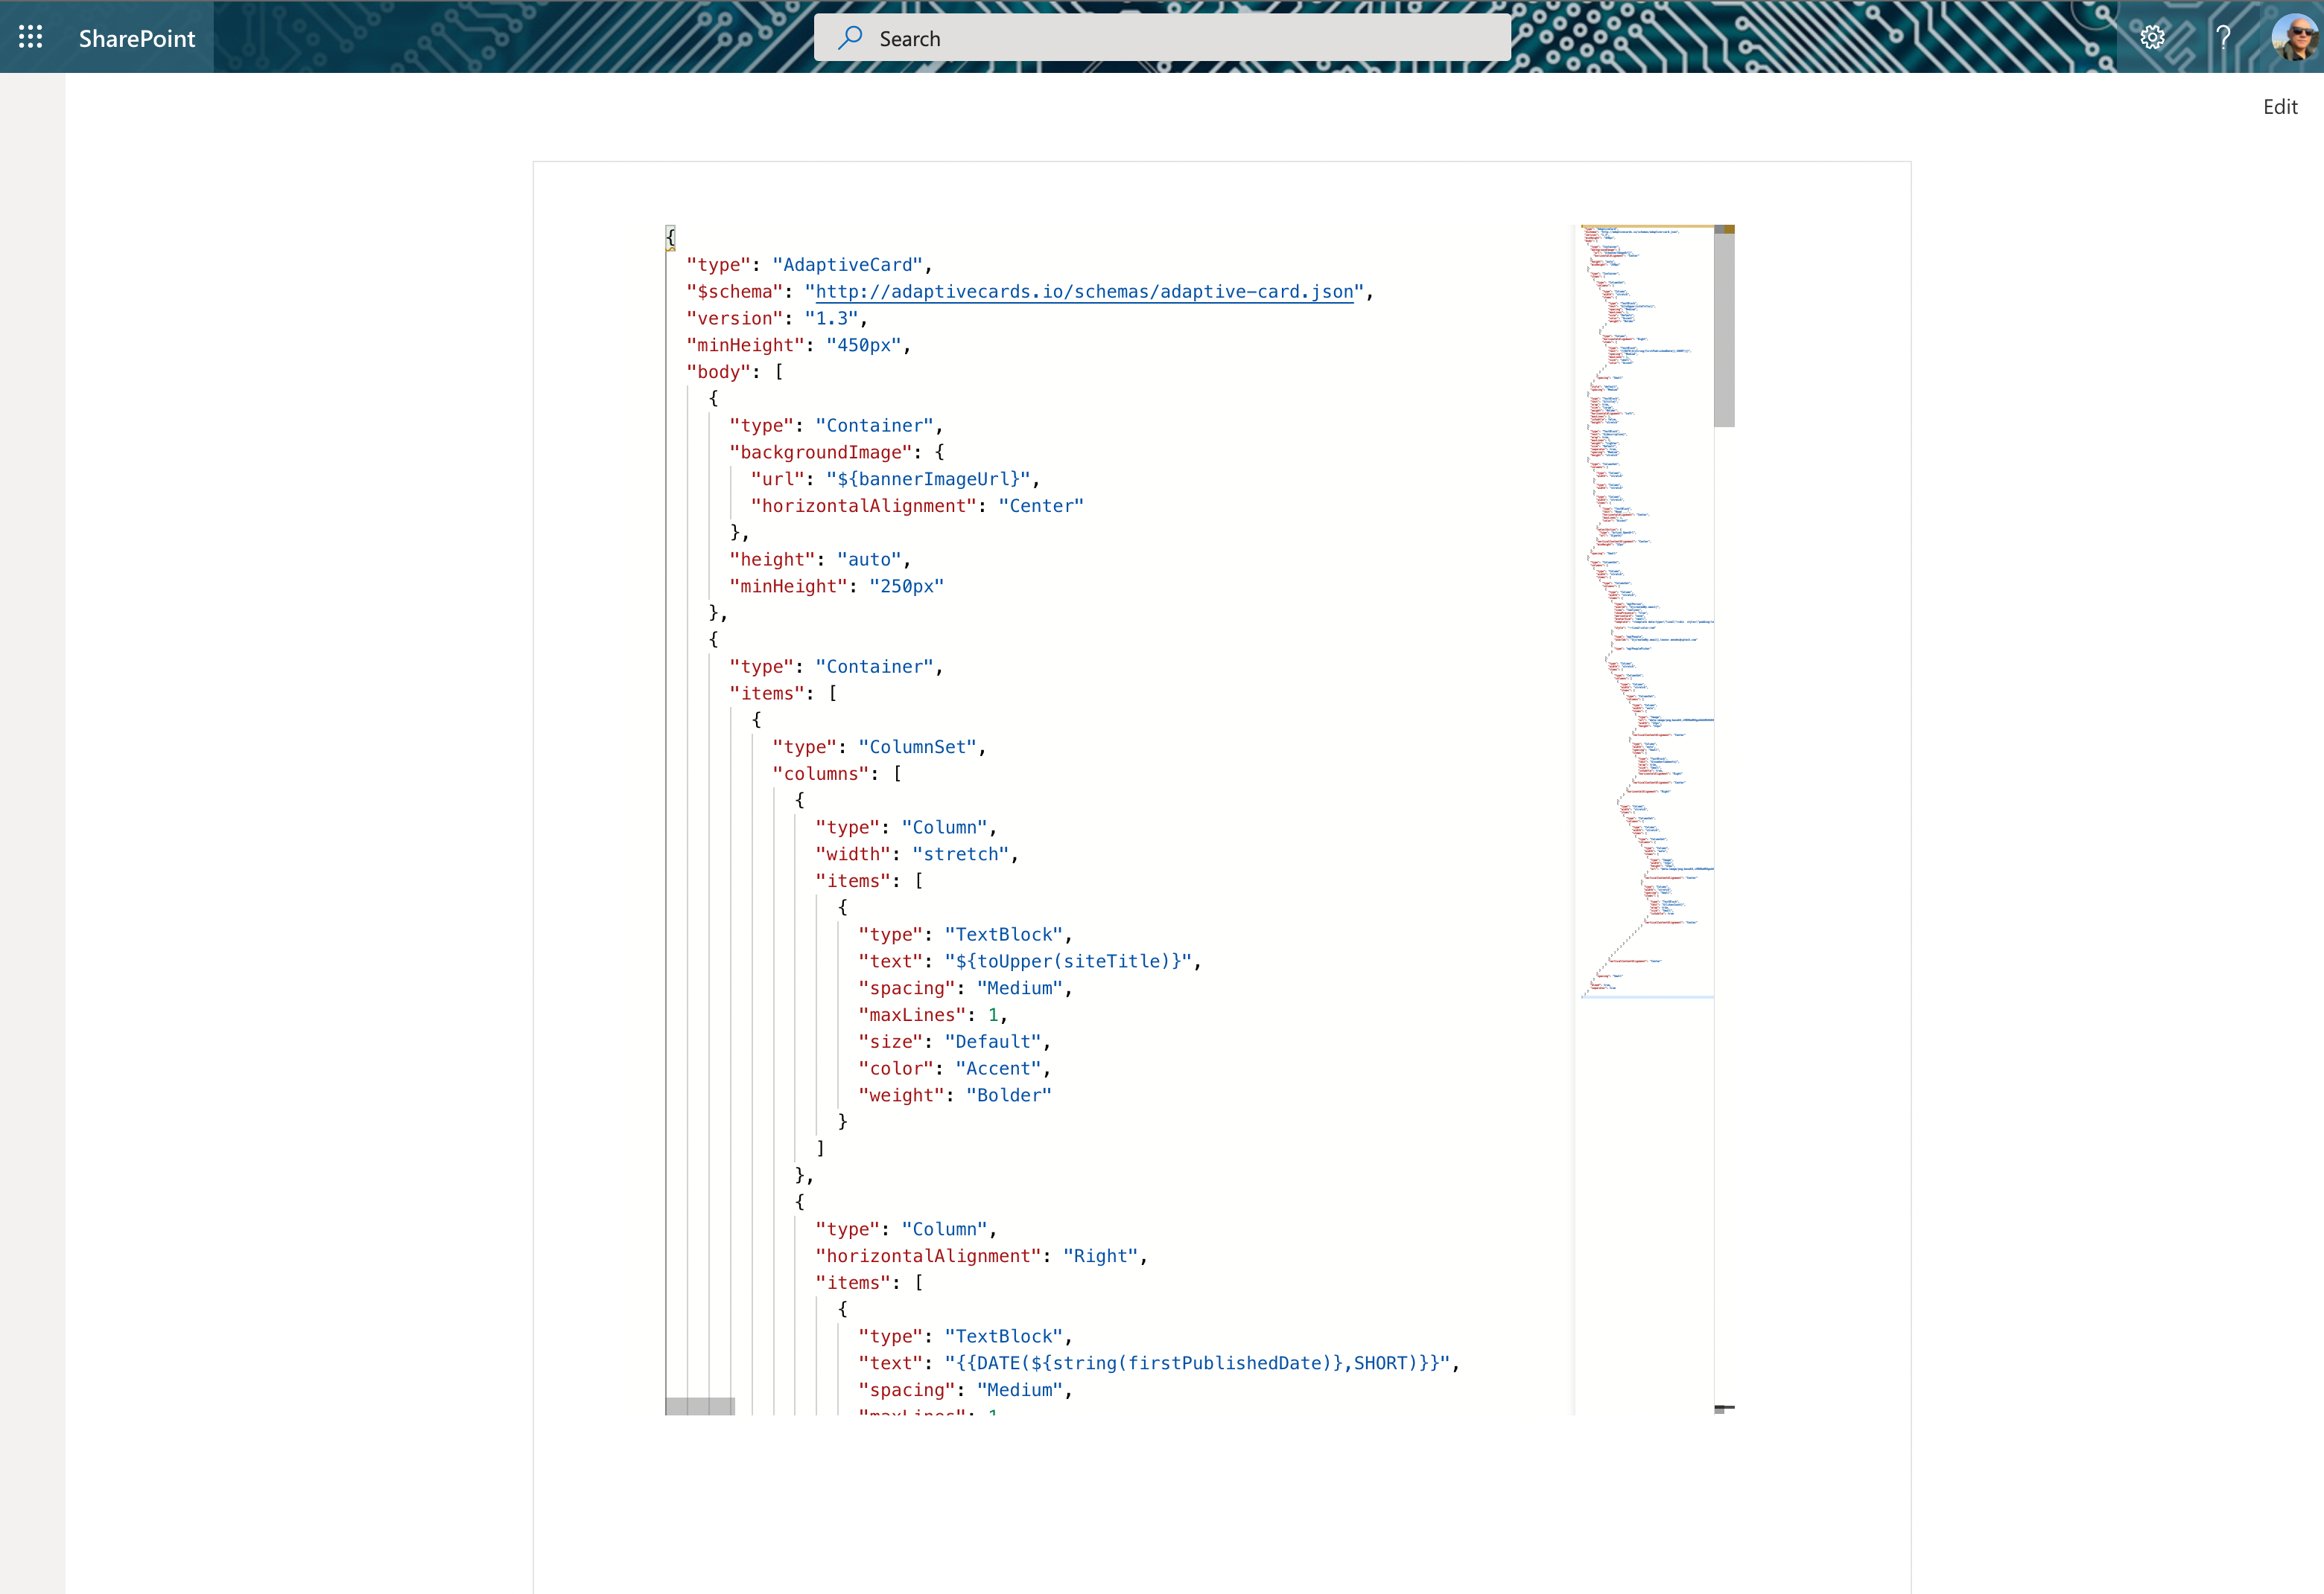
Reusable SPFx Controls
React Controls – 3.7.2
New VariantThemeProvider control
New MonacoEditor control
Enhancements for multiple controls: Carousel, TreeView
SPFx v1.14.0 support
Various fixes
Release notes: https://pnp.github.io/sp-dev-fx-controls-react/about/release-notes/
React Property Controls – 3.6.0
New MonacoEditor control
SPFx v1.14.0 support
Various fixes
Release notes: https://pnp.github.io/sp-dev-fx-property-controls/about/release-notes/
Special thanks to our contributors: Amir Msai, Chad Eiserloh, Fabio Franzini, GuidoZam, João Mendes, Mathijs Verbeeck, Rolands Strakis, Won Song.
More information:
https://sharepoint.github.io/sp-dev-fx-property-controls https://sharepoint.github.io/sp-dev-fx-controls-react
Twitter: @M365PnPControls

Slide 21
PnP SPFx Community Yeoman Generator

Slide 22
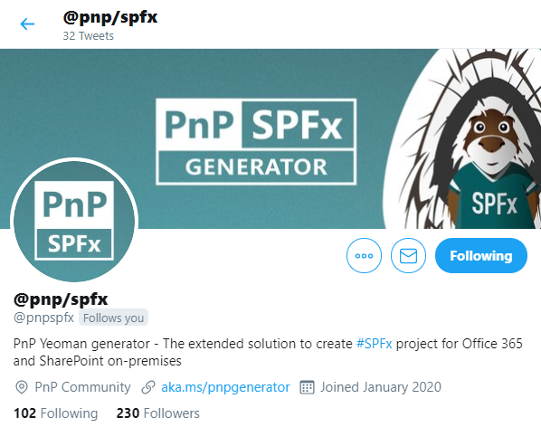
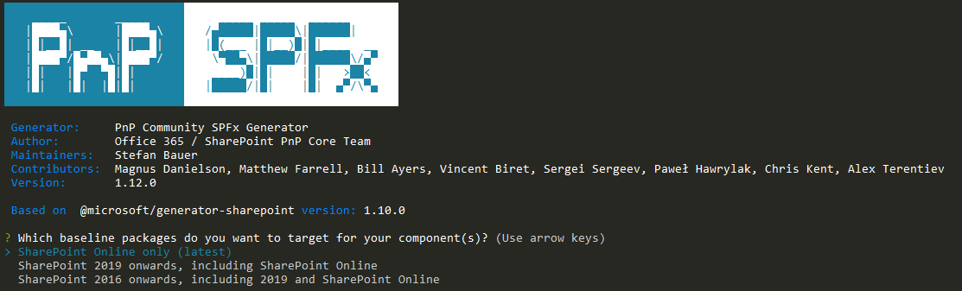







PnP SPFx Generator
@pnp/generator-spfx - 1.16.0
In progress and on the way to 1.17.0
Upgrade to SPFx 1.12.1 in progress
Drop of IE11 support (optional)
Angular 12 support
Update of outdated libraries
UPDATES REQUESTED
Install the latest version via npm: npm install -g @pnp/generator-spfx
Documentation: https://aka.ms/pnpgenerator
Chat on Gitter: https://gitter.im/generator-spfx/generator

Slide 23
PnP Modern Search

Slide 24
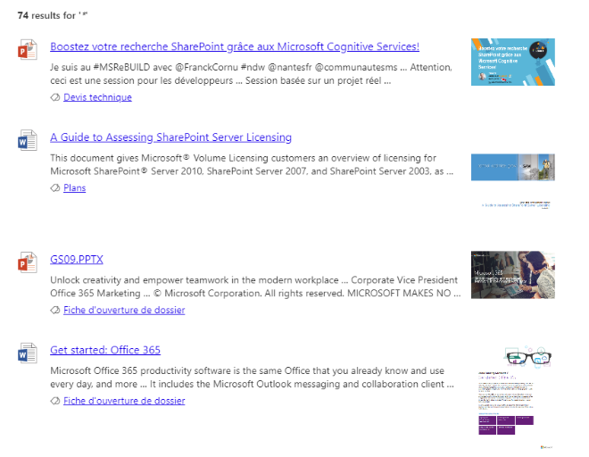

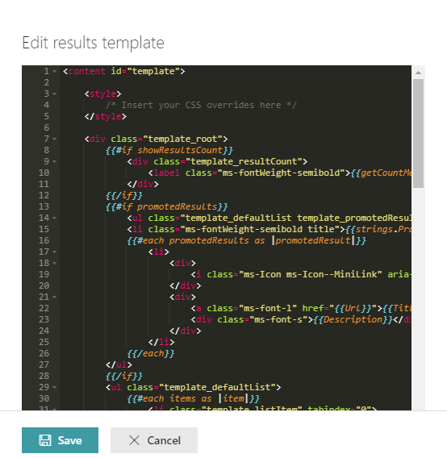
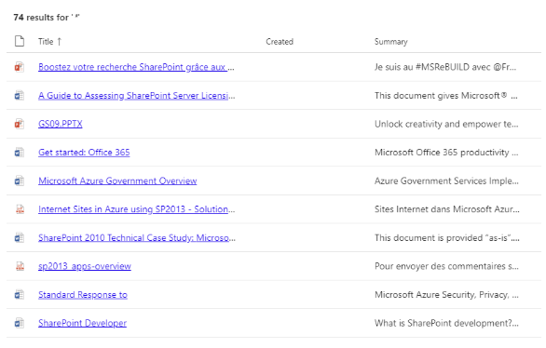


PnP Modern Search
http://aka.ms/pnp-search
Building modern Search experiences with flexible web parts
v4.6.1 – April 2022 release
https://github.com/microsoft-search/pnp-modern-search/releases/latest
Thank you @gszdev, @kachihro, @edarroudi, @eduardpaul, @dominiqueborer, @kflogdev for your support 😍
See release notes for fixes and new features
v3.23.0 – December 2021 release
https://github.com/microsoft-search/pnp-modern-search/releases
See release notes for fixes and new features
Notes:
https://github.com/microsoft-search/pnp-modern-search

Slide 25

PnP SPFx Samples

Slide 26
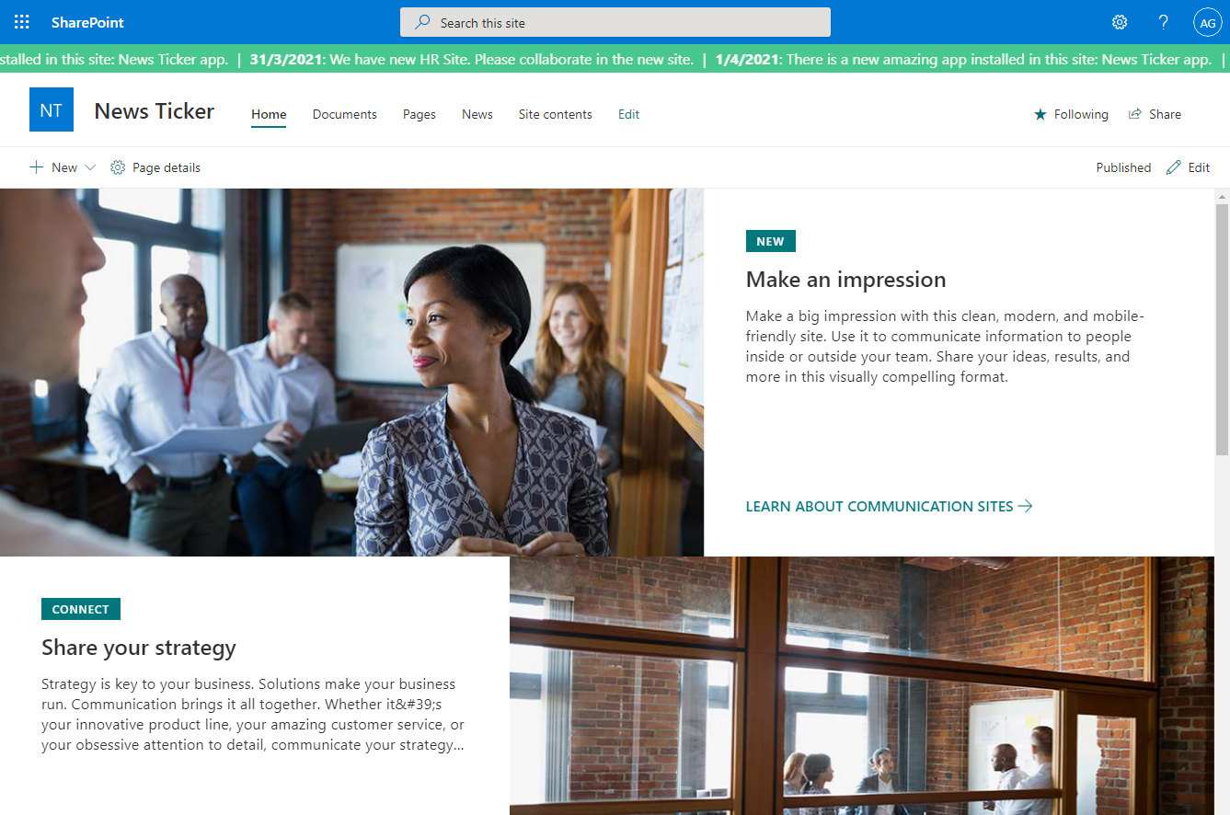
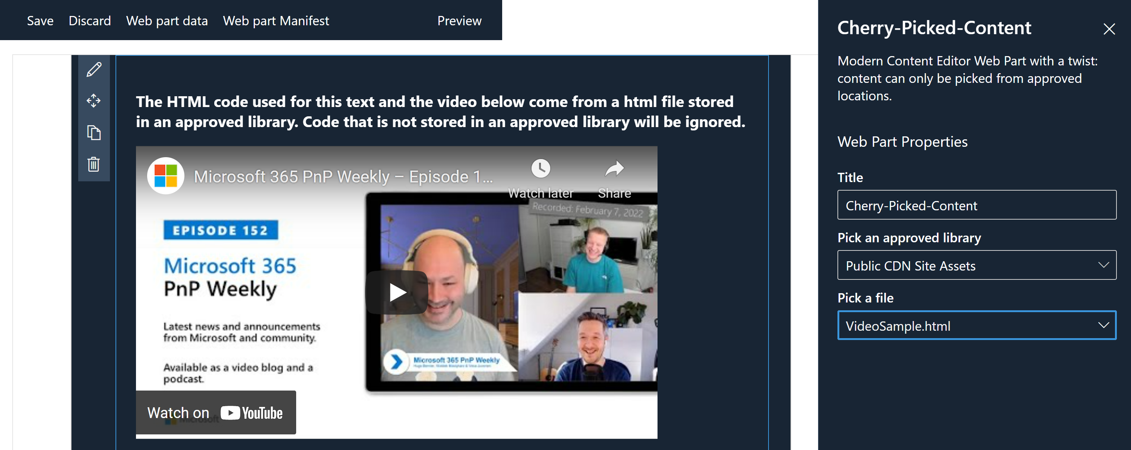
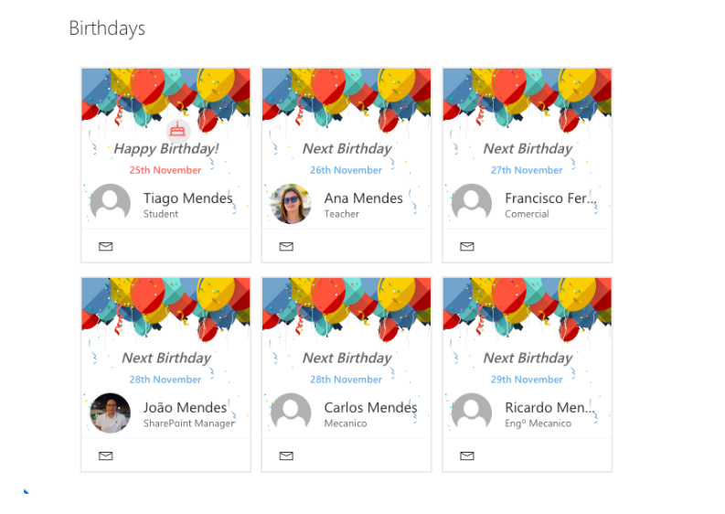
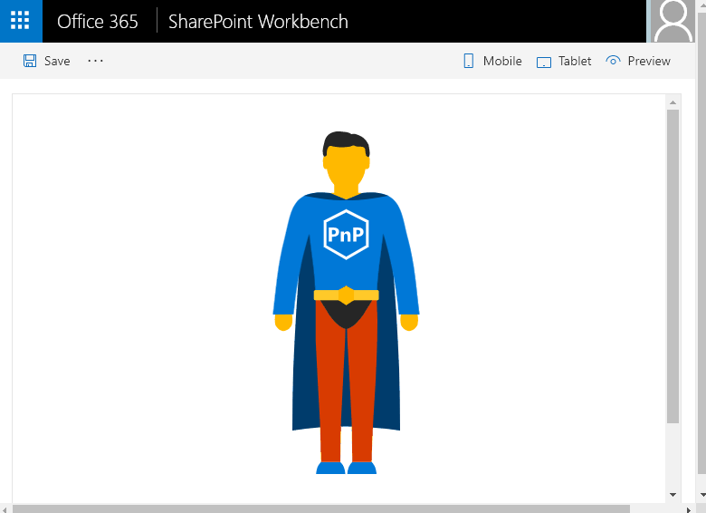
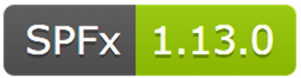
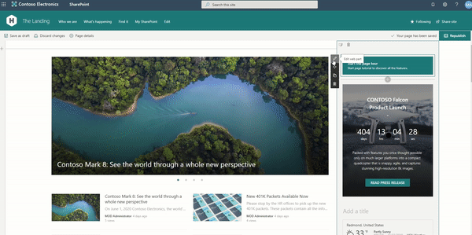
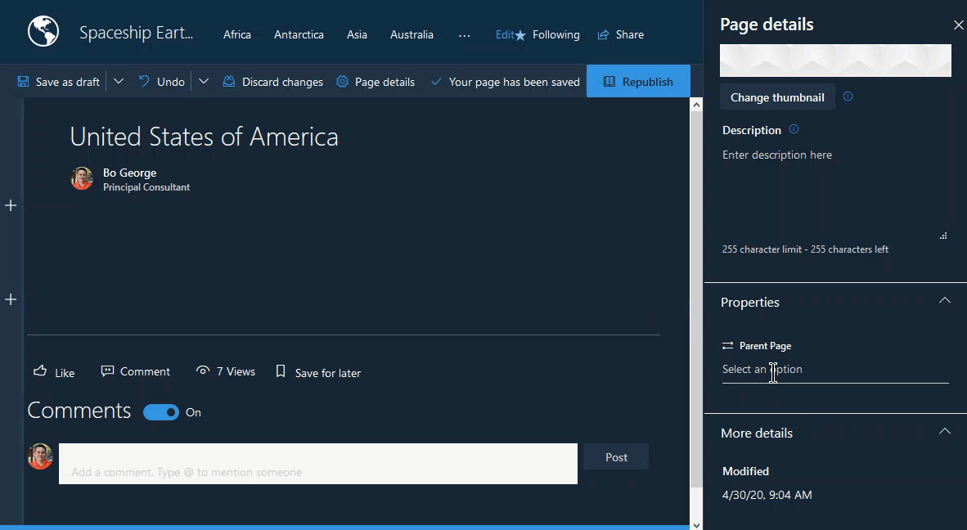
PnP SPFx Samples
PnP SPFx Samples
PnP SPFx Samples
https://aka.ms/spfx-extensions
News Ticker Sudharsan Kesavanarayanan | @sudharsank
https://aka.ms/spfx-webparts
NEW: FluentUI 9 Nick Brown| @techiekb
NEW: Tab Accordion with Rich Text Editing Arun Kumar Perumal | arunkumarperumal
Cherry-Picked Content Christophe Humbert | @Path2SharePoint
Birthdays Milan Holemans
Dynamic Scalable Vector Graphics (SVG) Nader Hadjebi | @nader2015
Tour Sample Mike Homol | @homol
To Do Client with Vue.js LOLCATATONIA
Pages Hierarchy Nick Brown| @techiekb
NEW: Group Members Nick Brown| @techiekb
Follow Documents André Lage | @aaclage
172 pull requests last 2 weeks
💖 Denis Molodtsov | @zerg00s, Abderahman Moujahid | Abderahman88, Milan Holemans | milanholemans
Notes:
If you’re starting a new development task with SPFx, you could build everything from scratch on your own,
OR you could leverage the awesome samples that were built by the community.
We have two GitHub repositories: SPFx Web Parts, and SPFx Extensions where you can find samples contributed by the community, ranging from simple concepts (like how to use a control, for example) to full solutions and utilities.
We welcome contributions from everyone.
These are the updates for the last two weeks
SPFx extensions https://aka.ms/spfx-extensions
News Ticker Sudharsan Kesavanarayanan | @sudharsank Upgraded to SPFx 1.14 and added properties for background color and text color https://github.com/pnp/sp-dev-fx-extensions/blob/main/samples/react-application-news-ticker
SPFx web parts https://aka.ms/spfx-webparts
NEW: FluentUI 9 Nick Brown| @techiekb
This demos the use of the new Fluent UI version 9 controls and theme provider. 1 UI framework which has native theming for Teams, SharePoint and Windows To be processed shortly
NEW: Tab Accordion with Rich Text Content Arun Kumar Perumal | arunkumarperumal This Web Part allows users to create content as Tabbed content using Property Field Collection Data and tinyMCE for Rich Text Editing targeted for SharePoint Online.
Provides options to view as an Accordion or Tab.
In mobile browser defaults to Accordion view.
https://github.com/pnp/sp-dev-fx-webparts/blob/main/samples/react-accordion-with-richtext
Cherry-Picked Content Christophe Humbert | @Path2SharePoint Fixes a bug in the getLibraryItemsList method.
https://github.com/pnp/sp-dev-fx-webparts/blob/main/samples/react-cherry-picked-content
Birthdays Milan Holemans
Upgraded to SPFx 1.14
https://github.com/pnp/sp-dev-fx-webparts/blob/main/samples/react-birthdays
Dynamic Scalable Vector Graphics (SVG) Nader Hadjebi | NaderHadjebi
Nawdeirh
Had an issue with a dependency, fixed it
https://github.com/pnp/sp-dev-fx-webparts/blob/main/samples/js-propertycontrols-svg
Tour Sample Mike Homol | @homol
A very quick update to the Tour web part to display the order of the web part, so now it's in the full order of section->column->web part ordering.
https://github.com/pnp/sp-dev-fx-webparts/tree/main/samples/react-tour-pnpjs
To Do Client with Vue.js LOLCATATONIA
Updated old sample and replaced node-sass with sass to resolve compatibility issues
https://github.com/pnp/sp-dev-fx-webparts/blob/main/samples/vuejs-todo-single-file-component/
Pages Hierarchy Nick Brown| @techiekb
Added a tree view
https://github.com/pnp/sp-dev-fx-webparts/blob/main/samples/react-pages-hierarchy
NEW: Group Members
Nick Brown| @techiekb
https://github.com/pnp/sp-dev-fx-webparts/blob/main/samples/react-group-members

Slide 27
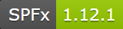
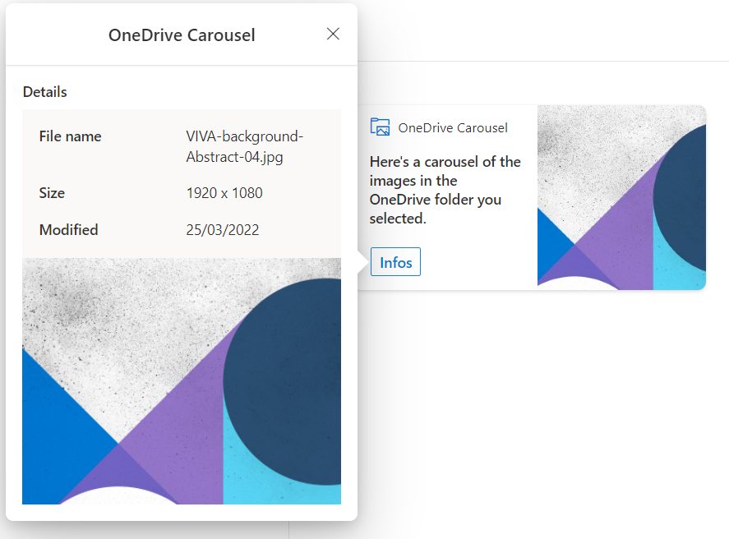
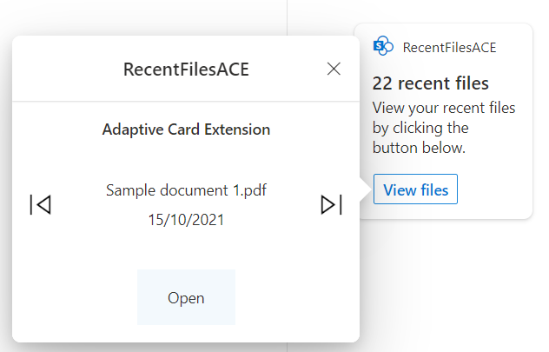
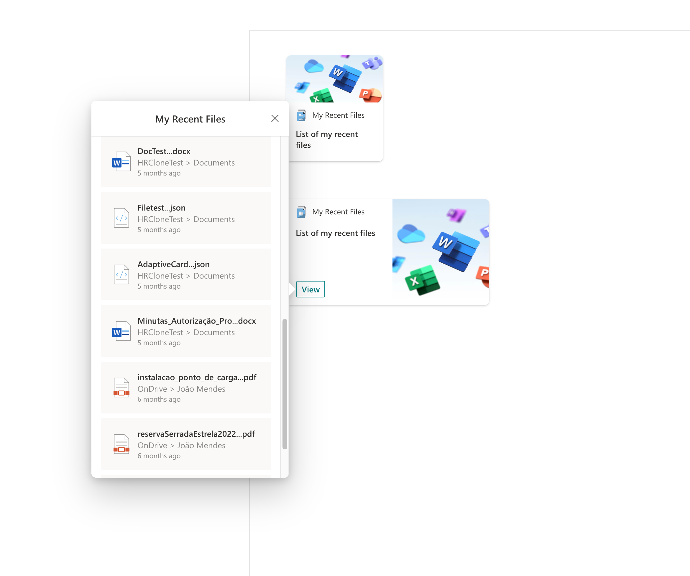
PnP SPFx ACEs
PnP SPFx Samples
PnP SPFx Samples
https://aka.ms/spfx-aces
OneDrive Carousel – Image Card OneDrive Carousel – Basic Card Guido Zambarda | GuidoZam
Recent Files – Counter & View Guido Zambarda | GuidoZam
Recent Files – Quick Access João Mendes | @joaojmendes
*** Open for More Contributions ***
Follow Documents André Lage | @aaclage
Notes:
This adaptive card extension sample demonstrate ability to monitor security risks using identity protection graph api from Viva Connection Dashboard
SPFx extensions https://aka.ms/spfx-extensions
Copy/Move Items within Lists Sudharsan Kesavanarayanan | @sudharsank This application customizer will display a command button named Copy/Move Item(s) in all the custom lists. Using this option, the items can be copied or moved from one list to another within the site.
https://github.com/pnp/sp-dev-fx-extensions/tree/main/samples/react-command-copy-move-items
SPFx web parts https://aka.ms/spfx-webparts
Applications Secrets Expiration Aimery Thomas | @a1mery This sample web part shows the list of your applications registered in Azure AD along with their associated client secret/certificate expiration date. https://github.com/pnp/sp-dev-fx-webparts/tree/main/samples/react-graph-app-secret-expiration
Teams Membership Updater
Nick Brown | @techienickb
Fixed the /members in the private channel membership URL
Advanced Page Properties Abderahman Moujahid | Abderahman88
Added support for web parts on sites in a different language
NEW: News Alison Collins | ReactIntern Web part pulls all SharePoint News Posts that the logged in user has access to view.
Pagination ( Back/Next ) and Page Display ( n out of n )
Select Multiple Sites ( Defaults to site webpart is deployed to )
Two styling options, Stack or Single
News Title as link ( Click to go to post )
News Thumbnail Image
Preview of Description
Author ( Can toggle visibility in Property Pane )
Created Date
Likes with Office UI Fabric Icons
Comments with Office UI Fabric Icons ( Also retrieves nested comments )
https://github.com/pnp/sp-dev-fx-webparts/tree/main/samples/react-news

Slide 28



Optional picture time!
Video on and we’ll grab a Together Mode pic with those who are willing to do this.
We are together on this as a community!
Let’s all be like Seb?
By enabling your camera for the picture, you grant us permission to share your picture in social media.

Slide 29

DEMO
Adaptive Card Design Gallery - Derek Cash-Peterson
Using Adaptive Cards control from the PnP control gallery in SPFx solutions - Fabio Franzini
Navigating Cards in Viva Connections ACEs
- Paolo Pialorsi

Slide 30
Thank you
Recording will be available in 24 hours on
Microsoft 365 Community (PnP) YouTube channel
https://aka.ms/M365PnP/videos
(subscribe today)
Follow us on Twitter
@Microsoft365Dev | @M365PnP
Next Viva Connections & SPFx call: May 5th at 07:00am PT
Next M365 General Dev call: April 28th at 07:00am PT
All available community calls from https://aka.ms/m365pnp

Slide 31


aka.ms/m365pnp

